Slide 1

UNIVERSITY DEPARTMENT, RAJASTHAN TECHNICAL UNIVERSITY, KOTA
DEPARTMENT OF Mechanical ENGINEERING
PROJECT PRESENTATION VII SEM
WARREN BUFFETT'S INVESTMENT STRATEGY AND WHY APPLE?
PRESENTED BY
SUBMITTED TO
ANISH SONI (21/189)
Sh. Gitesh Vijay
Associate Professor

Slide 2
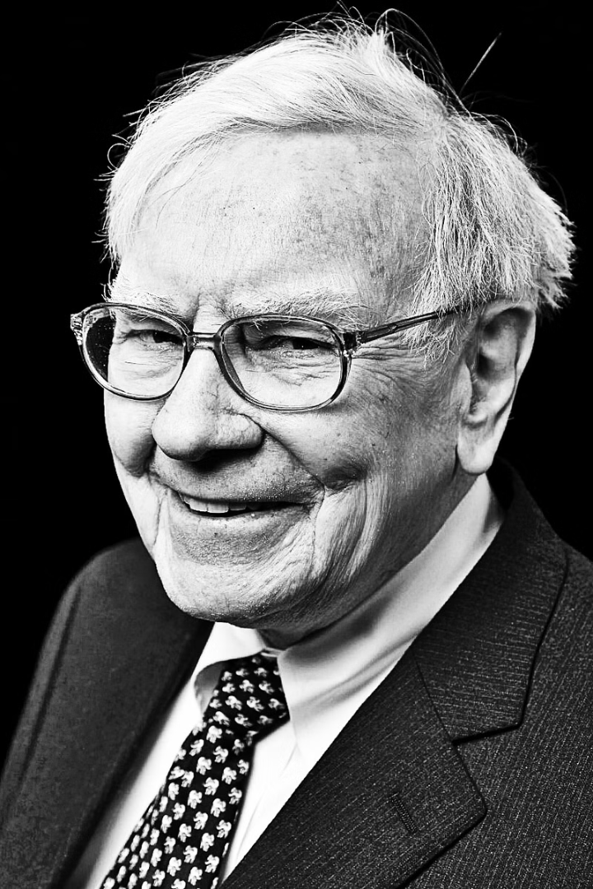
Warren Buffett's Investment Strategy and Why Apple?
Explore the investment principles and portfolio decisions of the legendary investor Warren Buffett, and dive into his rationale for Apple being a top holding in his portfolio.
Notes:
1

Slide 3
Buffett's Investing Principles
01
02
03
Value
Moat
Management
Buffett seeks undervalued companies with strong fundamentals and growth potential.
He looks for businesses with sustainable competitive advantages and barriers to entry.
Buffett invests in companies with proven, shareholder-friendly leadership teams.
Notes:
2

Slide 4

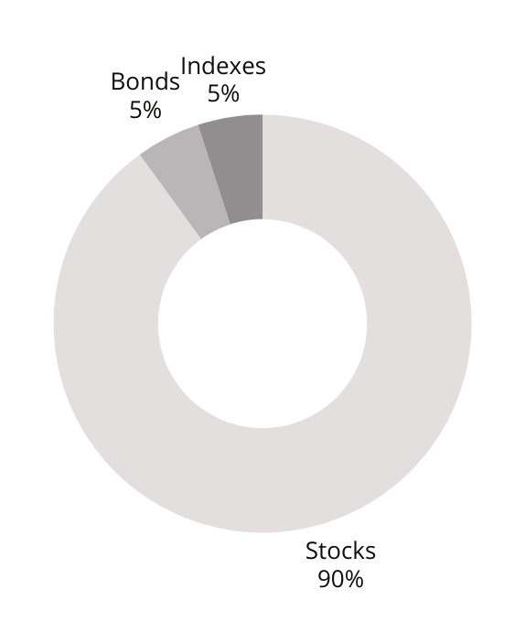
Buffett's Portfolio Allocation
Depending on your risk profile put your money in different funds
Equities (60-80%)
Fixed Income (10%)
Buffett maintains a significant exposure to the stock market, seeking long-term growth.
He allocates a portion of his portfolio to lower-risk fixed income investments.
ex: short-term government bonds

Slide 5
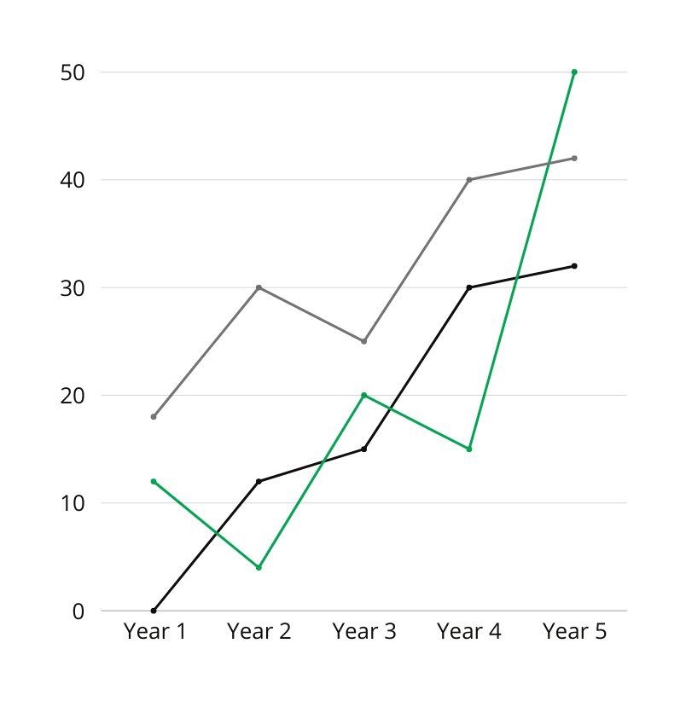
Buffett's Holding Period
Investing regularly pays off in the long term
1
Average 10+ Years
Buffett is known for his patient, long-term approach to investing.
2
Patience is Key
He believes that time in the market is more important than timing the market.
3
Compounded Growth
Buffett's long-term focus allows for the power of compounding to work in his favor.

Slide 6



Buffett's Top Holdings
Are you a conservative, moderate or aggressive investor?
Coca-Cola (9%)
Bank of America (12%)
Apple (44%)
A long-standing Buffett holding, showcasing his preference for iconic consumer brands.
A major banking investment, demonstrating Buffett's belief in the financial sector.
Buffett's largest holding, reflecting his confidence in the tech giant's long-term prospects.

Slide 7
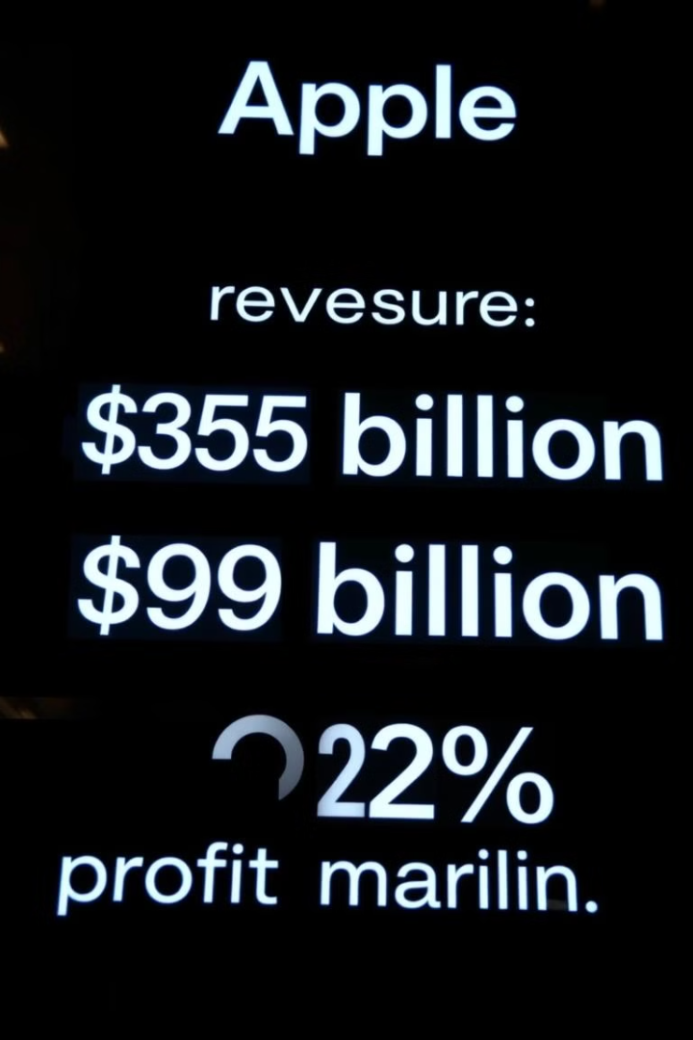


Apple's Financials
$365 Billion Revenue
$99 Billion Net Income
Apple's massive scale and global reach drive its industry-leading financial performance.
Apple's strong profitability, with a 22% profit margin, demonstrates its operational excellence.

Slide 8

Apple's Competitive Advantage
1
Ecosystem
2
Brand
Apple's tightly integrated hardware, software, and services create a powerful ecosystem.
Apple's iconic brand and reputation for innovation attract loyal customers worldwide.
3
Innovative Products
Apple's continuous development of cutting-edge products drives its market leadership.
Notes:
7

Slide 9
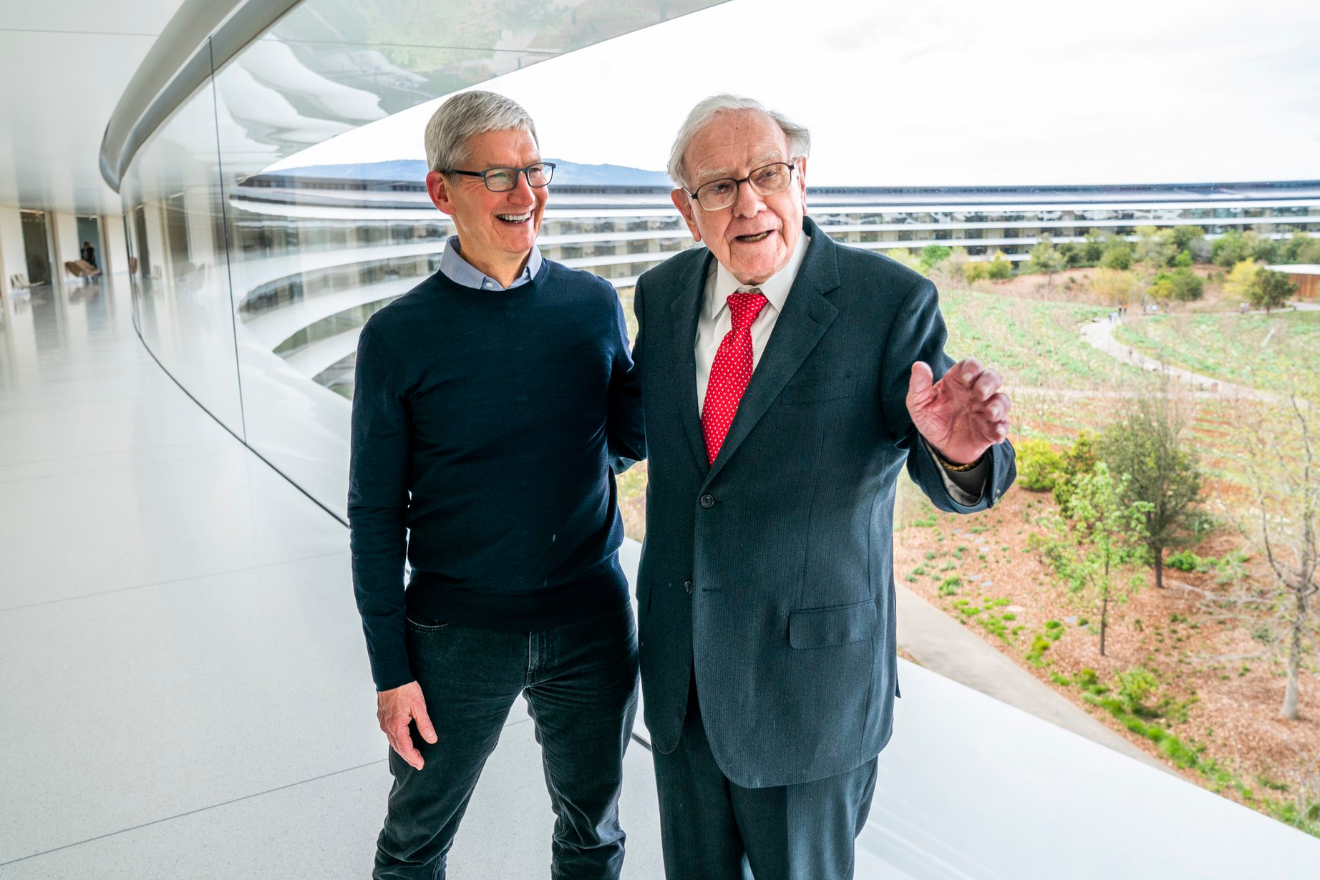


Why Buffett Loves Apple?
Visionary Leadership
Buffett admires Apple's innovative culture and the visionary leadership of CEO Tim Cook.
Strong Moat
Apple's ecosystem and brand create a sustainable competitive advantage, a key Buffett criterion.
Predictable Earnings
Apple's strong financial performance and brand loyalty provide reliable earnings growth.
Notes:
8

Slide 10

College ID
Thank You
21EUCCS014
Email Address
anish.21cse189@rtu.ac.in
Website
www.anishsoni.com

